Slide 1

Recent changes in the software for
registration of zebrafish embryos
Martin Burger, Lena Frerking, Fjedor Gaede, Daniel Tenbrinck
Department of Computational and Applied Mathematics, WWU Münster
Talk at the ZMBE
Bordeaux, 29.09.2016

Slide 2
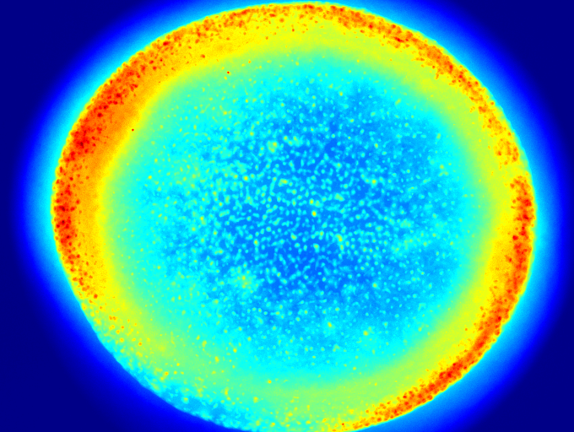
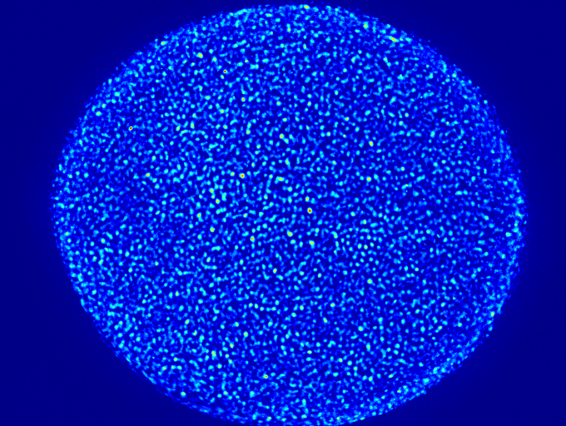
Preprocessing (DAPI channel)
Method: Use morphological filtering to remove background
before filtering
after filtering

Slide 3
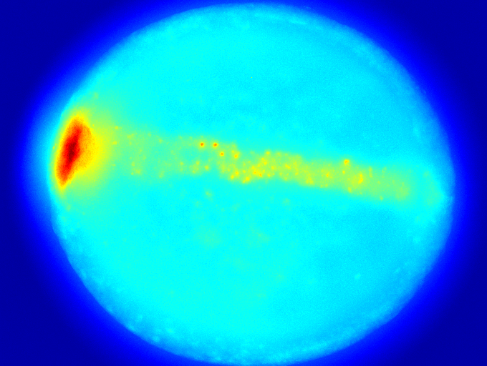
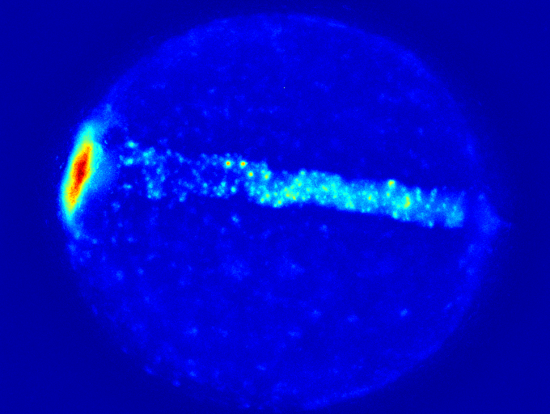
Preprocessing (GFP channel)
Method: Use morphological filtering to remove background
before filtering
after filtering

Slide 4
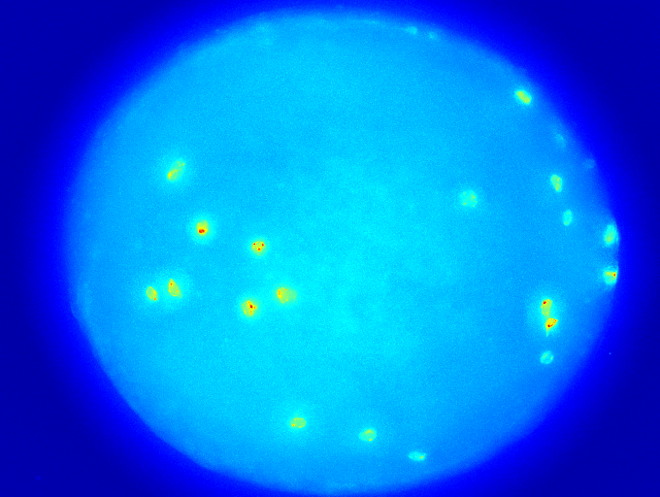
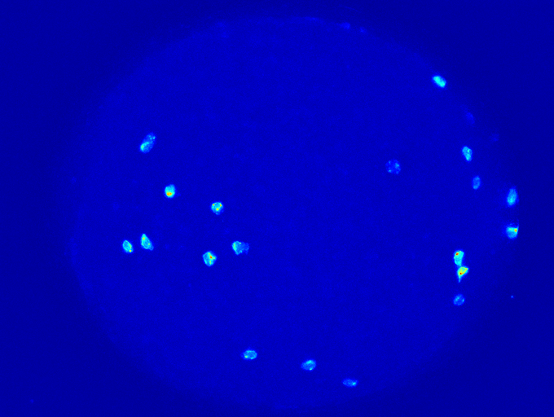
Preprocessing (mCherry channel)
Method: Use morphological filtering to remove background
before filtering
after filtering

Slide 5
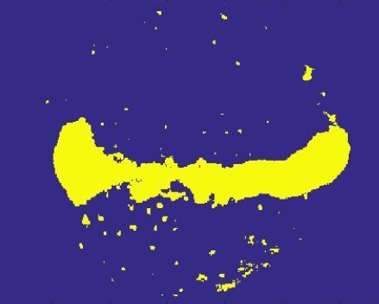
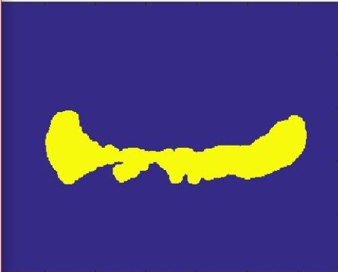
Segmentation with filtering
Without filtering
With filtering

Slide 6
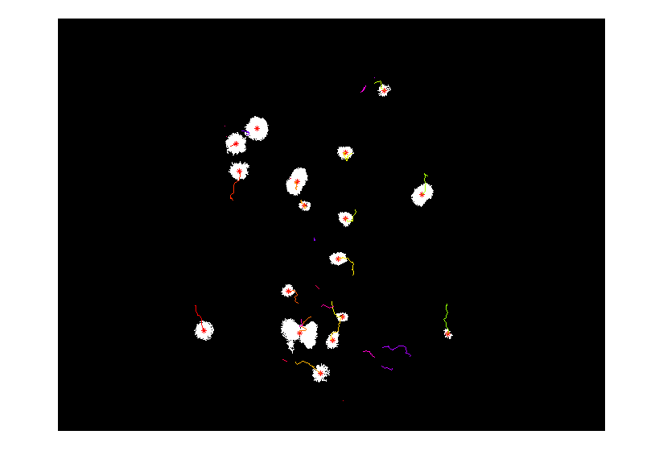
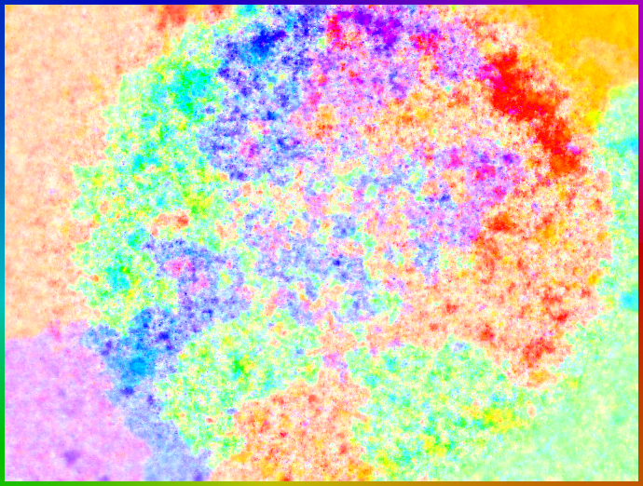
Optical flow on DAPI channel
Cell tracking on mCherry channel

Slide 7
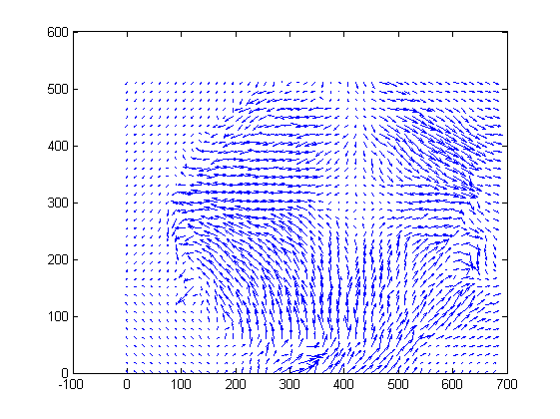
Optical flow on DAPI channel
Cell tracking on mCherry channel

Slide 8
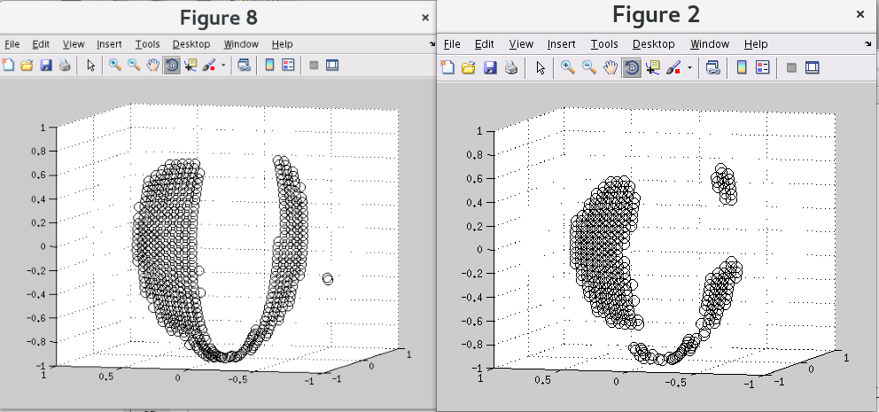
Projection onto unit sphere
Projection of GFP landmark before changes
Projection of GFP landmark after changes

Slide 9
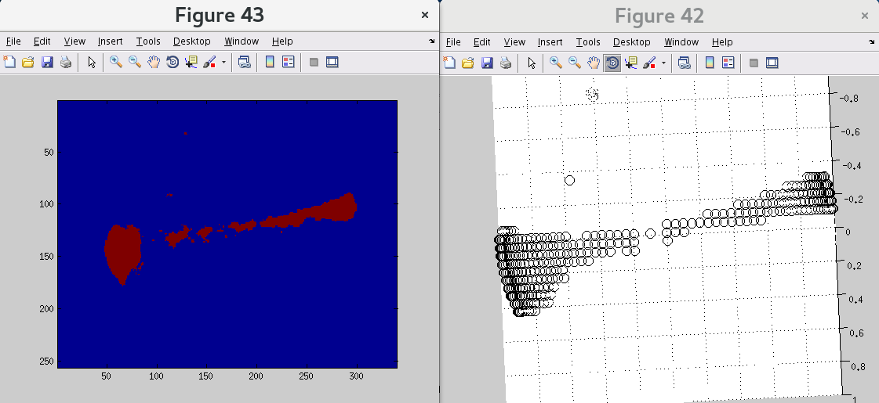
Projection onto unit sphere
MIP of segmented GFP landmark
Projection of GFP landmark

Slide 10
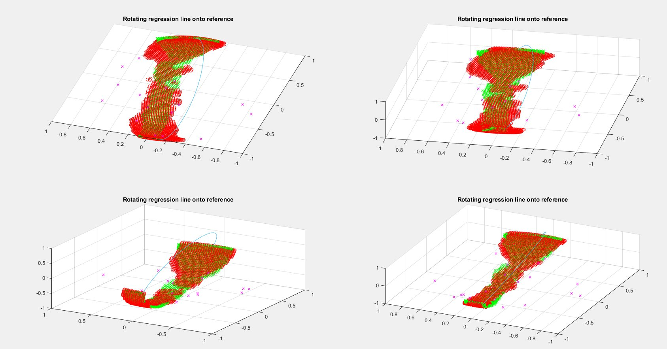
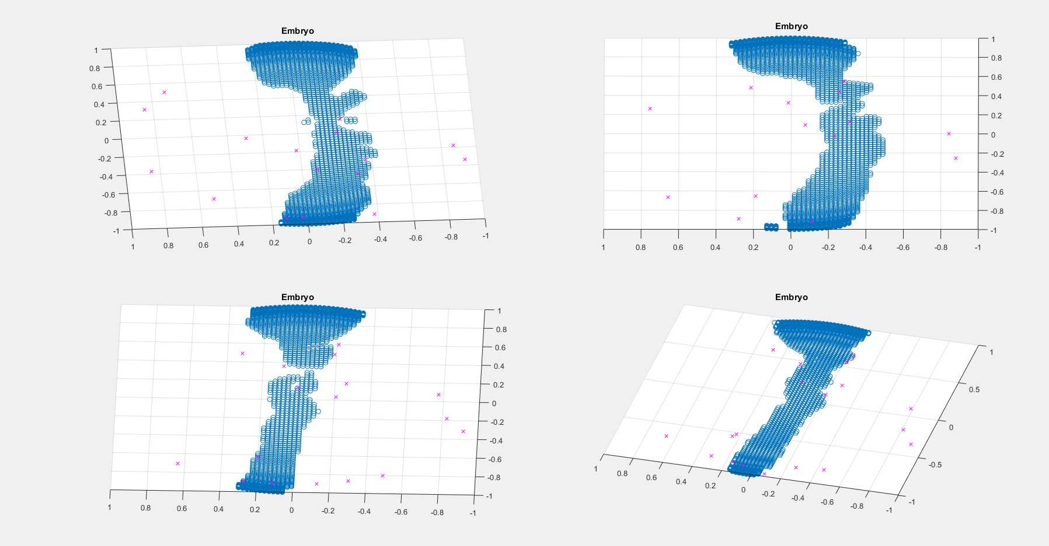
Registration
Embryos before registration

Slide 11
Registration
Registration of all Embryos onto one reference Embryo

Slide 12
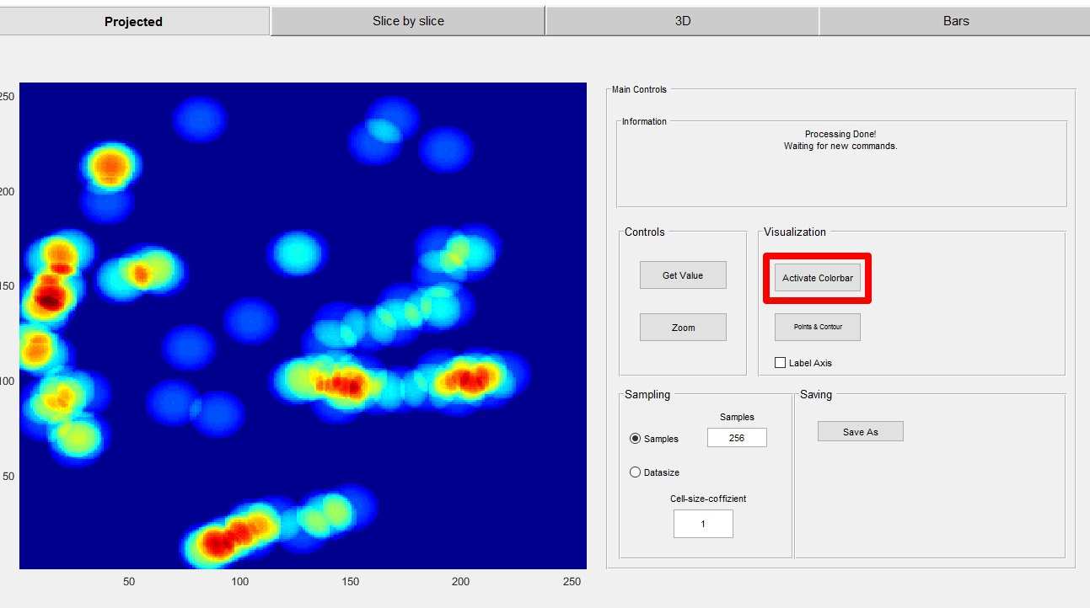
GUI changes

Slide 13
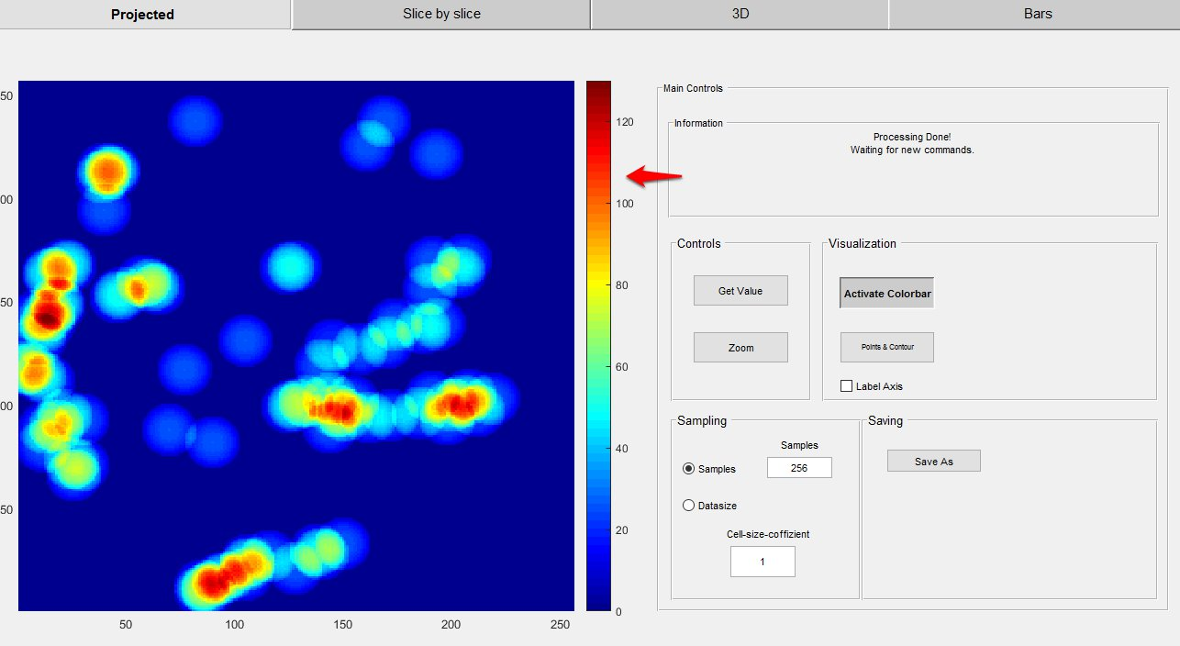
GUI changes

Slide 14
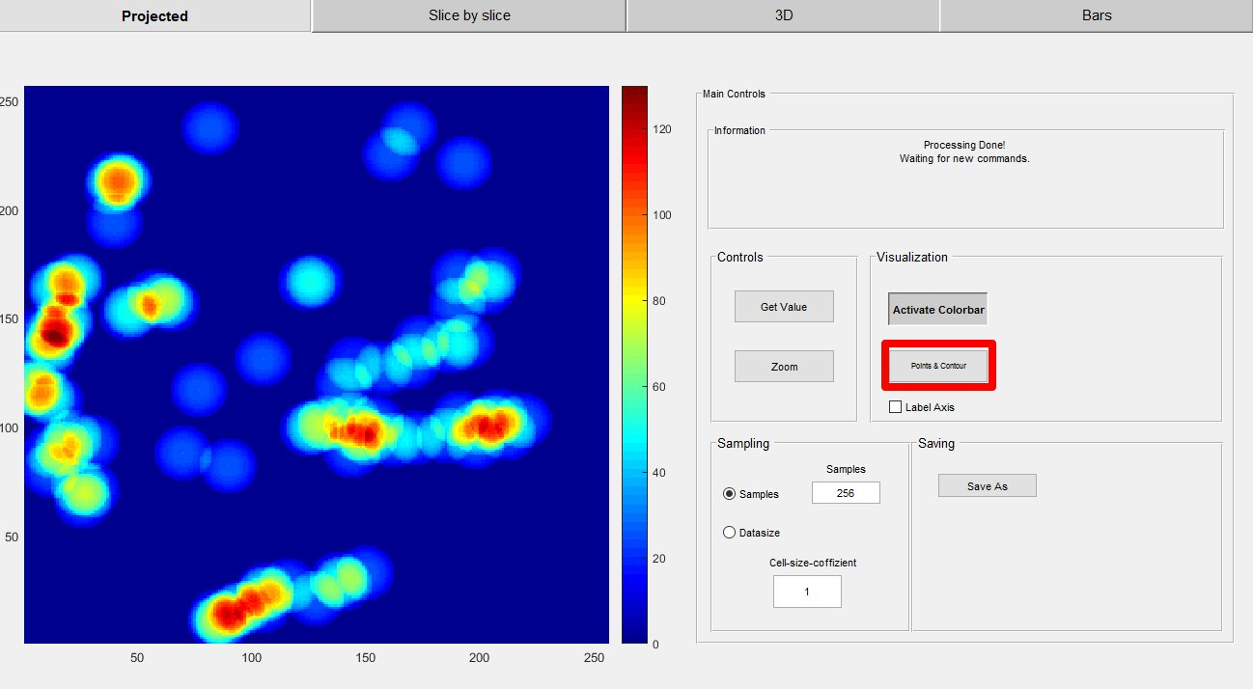
GUI changes

Slide 15
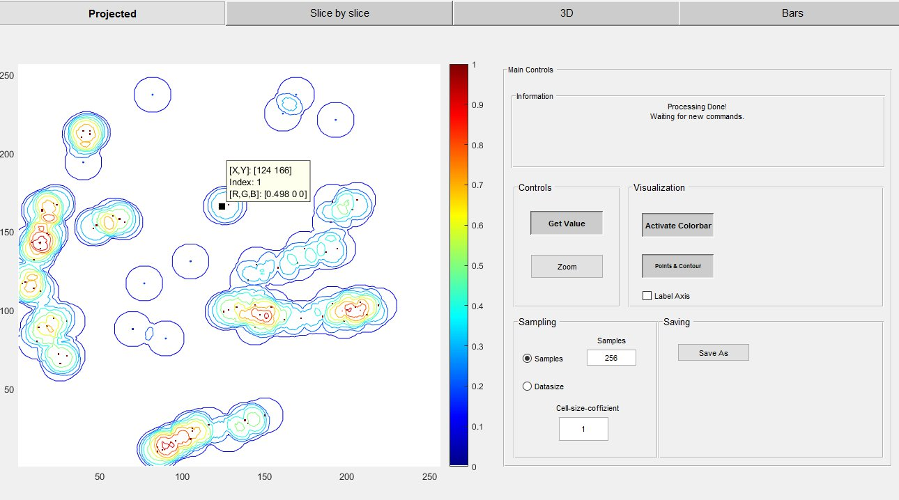
GUI changes

Slide 16
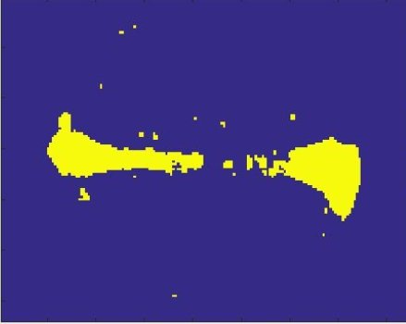
Problem cases

Slide 17
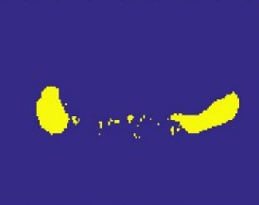
Problem cases

Slide 18
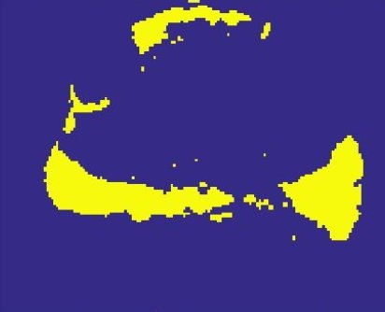
Problem cases

Slide 19
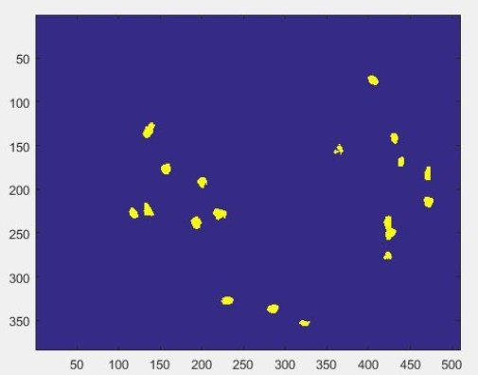
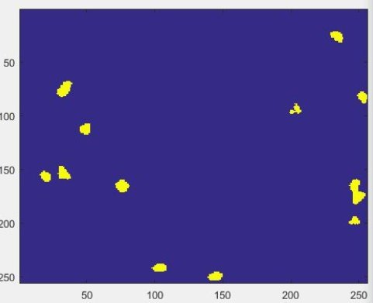
Problem cases

